Slide 1

Techniques for Multi-Standard Cognitive Radios on FPGAs
PhD oral defense
Pham Hung Thinh
School of Computer Engineering
Supervised by
Asst. Prof. Suhaib A Fahmy and Assoc. Prof. Ian McLoughlin

Slide 2




OUTLINE
Research Introduction
Motivation
Objective
Contributions
Background Literature
Research Contributions
Conclusions and Future Work
Notes:
This is presentation outline.
First, I will present the Research Introduction that includes Research motivation, research objective and the thesis’s contributions
Second, Background Literature is considered to provide an overview and basic knowledge on the researches in this thesis.
Then, I will discussed in detail on the main research contributions.
Last, the conclusion and future work will be given

Slide 3



Research Introduction
Wireless Applications
Handheld Communication
Vehicle Communication
Notes:
Nowadays, The wireless applications are developed rapidly to make the social life better.
Vehicle communication provides information helps the transportation more efficient and safe.
Handheld communication make people life more convenient and dynamic.
Wireless applications also be used widely in medical divide and healthcare systems.
There are many challenges are raised.
It’s requires a long life battery and/or a low-power design.
In high mobility app, Wireless system need to be robustness against dispersion effect of Doppler, multipath and fading, frequency offset.
Modern wireless system is highly adaptive, robustness against channel changing, flexible employment, different functions to provide the quality and reliability .
Last but not Least, Spectrum is limited resource that require the next generation wireless system to be able to dynamic spectrum access to reuse idle spectrum.

Slide 4
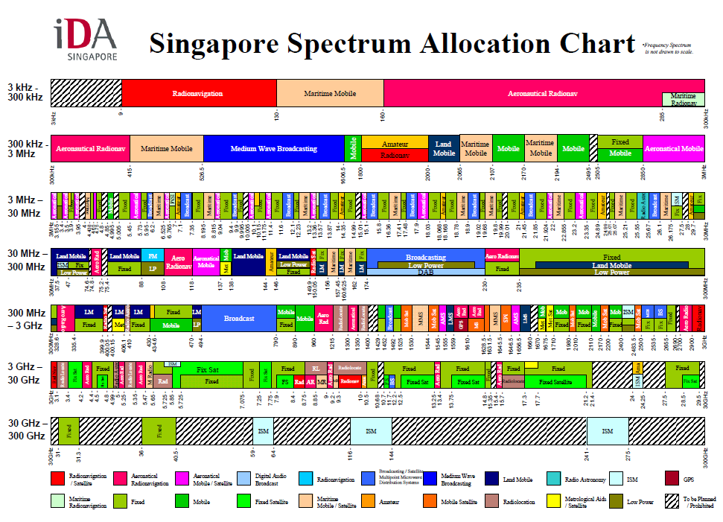
Research Introduction
Lack of spectrum
Source: http://www.ida.gov.sg/ (16-July-2012)
Notes:
The Fig. shows Singapore Spectrum Allocation. The spectrum resource chart is going to fill up in particularly for frequency bands below 30GHz.

Slide 5
Research Introduction
Low power system
WiFi(802.11)
WiMax(802.16)
Multi-Standard
Cognitive Radios
LTE
Efficient Spectrum Usage
Adaptation
WRAN(802.22)
Notes:
CR emerges to be a suitable solution for next generation wireless technology.
Systems sense the environment, learn and adapt to improve the communication quality.
Sense and be aware of spectrum usage of licensed users, then adapt parameters to send signal in idle spectrum.
Needs a flexible and adaptive physical layer in order to perform the required tasks efficiently.
Multiple Standard Cognitive Radios with the agility to operate in multiple frequency bands are hence a more flexible generalisation of CRs.
Given the ability to perform spectral sensing, and handle flexible carrier allocation, OFDM is widely considered a suitable candidate for future MSCR systems.

Slide 6
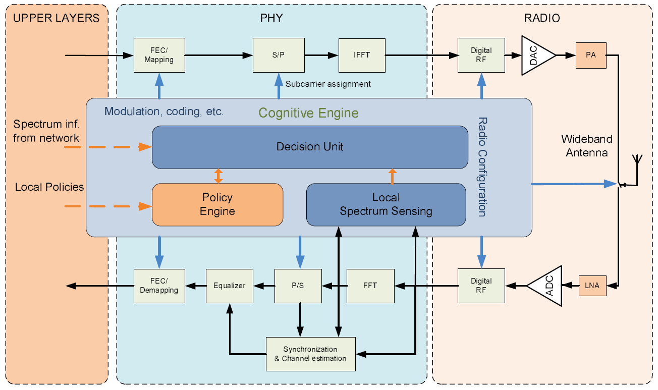
Research Introduction
Research Objective:
Our research focuses on low power physical layer for CRs to improve performance and provide flexibility.
PHYSICAL LAYER
Source: Mahmoud et. al., OFDM for Cognitive Radio: Merits and Challenges, IEEE Wireless Communication, vol.16, no.2, pp.6-15, April 2009.
Notes:
The Figure shows block diagram of a CR. It includes layers similarly to conventional wireless system, However, these layers must provide adaptation and flexibility.
An Cognitive Engine does cross layer interaction to perform the functionalities of CR.

Slide 7

Research Introduction
Research Objective:
Enhance OFDM Synchronisation for MSRC
Dynamic Spectral Leakage Filtering on CRs
Agile and Reduced Config. Time Architecture
Notes:
Despite several advantages, OFDM has intrinsic disadvantages related to synchronisation.
These become critical challenges when OFDM is used for cognitive radio.
In multiple standard radios, the RF front-end is required to have the ability to rapidly switch carrier frequency across a wide frequency range.
Such agility is difficult to achieve while ensuring that CFO is tightly constrained.
New synchronisation methods are therefore required for use in OFDM-based systems that are robust to large CFO.
In this thesis, we present a novel method that is both robust, and computationally efficient.
Secondly, CRs normally demand small spectral leakage for both in-band and out-of-band of transmitted signals, whereas OFDM is well known to induce significant amounts of spectral leakage.
We research on a frequency guard extending technique for spectral leakage compression.
This can meet the spectral leakage requirements, offering good out of band attenuation allowing deployments for dynamic spectrum access.
The overriding objective for this research is a low power and agile architecture for multi-standard cognitive radios on FPGAs, based on coupling PR modules and parameterised modules, incorporating the spectral leakage and synchronization methods mentioned above.

Slide 8
Research Introduction
Research Contributions:
A multipilerless correlation technique for OFDM timing synchronisation.
T. H. Pham, S. A. Fahmy, and I. V. McLoughlin, “Low-power correlation for IEEE 802.16 synchronisation on FPGA," in IEEE Transactions on Very Large Scale Integration (VLSI) Systems, vol. 21, no. 8, pp. 1549 – 1553, Aug. 2013.
A novel OFDM synchronisation method combining robust performance with computational efficiency
T. H. Pham, I. V. McLoughlin, and S. A. Fahmy, “Robust and Efficient OFDM Synchronisation for FPGA-Based Radios,” in Circuits, Systems, and Signal Processing, vol. 33, no. 8, pp. 2475 - 2493, Aug. 2014, Springer.
A novel IFO estimation technique that reduces both the power and computational cost in robust OFDM implementations.
T. H. Pham, S. A. Fahmy, and I. V. McLoughlin, “Efficient Integer Frequency Offset Estimation Architecture for Enhanced OFDM Synchronisation," in IEEE Transactions on Very Large Scale Integration (VLSI) Systems, 2015.
Notes:
This thesis has the contributions at a platform level, algorithm level and signal processing techniques to create a general OFDM-based FPGA architecture with a high level of adaptation and parameterisation.
A multipilerless cross-correlation technique for OFDM timing synchronisation.
We show that wordlength can be optimised to maintain synchronisation performance while minimising area, and also making the design suitable for FPGA devices with a small number of DSP blocks like the low power Xilinx.
A novel OFDM synchronisation method combining robust performance with computational efficiency.
We introduce an improved timing metric for synchronisation, resulting in significant efficiency improvements over other methods in the literature. This provides robust fractional CFO estimation and STO estimation over a range of channels.
In particular, it is robust to larger CFO ranges than many state-of-the-art synchronization implementations can handle.
A novel IFO estimation technique that reduces both the power and computational cost in robust OFDM implementations.
Robust OFDM synchronisation with IFO estimation at baseband is important to allow the RF front-end specification to be relaxed, thus reducing system cost.

Slide 9
Research Introduction
Research Contributions:
A novel filtering scheme for adaptively shaping the spectral leakage of OFDM signals.
T. H. Pham, I. V. McLoughlin, and S. A. Fahmy, “Shaping Spectral Leakage for IEEE 802.11p Vehicular Communications," in Proceedings of IEEE Vehicular Technology Conference (VTC Spring), Seoul, Korea, May 2014.
T. H. Pham, S. A. Fahmy, and I. V. McLoughlin, “Spectrally Efficient Emission Mask Shaping for OFDM Cognitive Radios,” under review for Digital Signal Processing.
A system-level approach for designing multi-standard radios on FPGAs.
T. H. Pham, S. A. Fahmy, and I. V. McLoughlin, “Efficient Multi-Standard Cognitive Radios on FPGAs," PhD Forum Poster in Proceedings of the International Conference on Field Programmable Logic and Applications (FPL), Munich, Germany, September 2014.
T. H. Pham, S. A. Fahmy, and I. V. McLoughlin, “Efficient OFDM-based baseband processing for Multi-Standard Cognitive Radios on FPGAs," in preparation for submission to ACM Transactions on Embedded Computing Systems.
Notes:
A novel filtering scheme for adaptively shaping the spectral leakage of OFDM signals according to the transmitted power and Spectrum Emission Mask requirements. The method proposed in this research is the first implementation technique that can achieve the specification for the most stringent SEM of 802.11p and 802.11af.
A system-level approach for designing multi-standard radios on FPGAs.
We show that by mixing partial reconfiguration (PR) with static parameterised modules, it is possible to minimise reconfiguration time compared to a full PR implementation.
It is possible to buffer internal data while reconfiguring the radio, leading to no loss during reconfiguration.

Slide 10
OUTLINE
Research Introduction
Background Literature
Cognitive Radios
OFDM
FPGA
Contributions
Conclusions and Future Work

Slide 11

Cognitive Radios
Software Defined Radios (SDR): a flexible platform for implementing specific radio systems
Cognitive Radio (CR): an evolution of SDR in adapting the radio to a changing environment.
Multi-Standard Cognitive Radio(MSRC): operate in multiple frequency bands with different specified standards, providing greater flexibility.
Notes:
Software Defined Radios are radio communication systems in which the processing components are realised by means of software on a computer or embedded system instead of in hardware circuits. SDR provides a flexible platform on which application specific radio systems can be implemented.
Cognitive Radio (CR) is an evolution of SDR incorporating intelligence in adapting the radio to a changing environment.
Recently, CR has gained further importance due to spectrum scarcity and inefficient spectrum usage.
CRs enable a situation where spectrum allocated to licensed users, known as Primary Users, can be reused by unlicensed users,
referred to as Secondary Users, when the Primary Uses are not using it.
Apart from the critical issues of sensing for unused spectrum and allocating bands for transmission, the lower priority
of SUs presents a problem in terms of transmission capability and quality of service.
If the spectrum bands allowed for a CR are fully occupied by Primary Uses and incumbent users transmission might be blocked.
Multi-standard cognitive radios can operate in multiple frequency bands with different specified standards, providing greater flexibility.

Slide 12
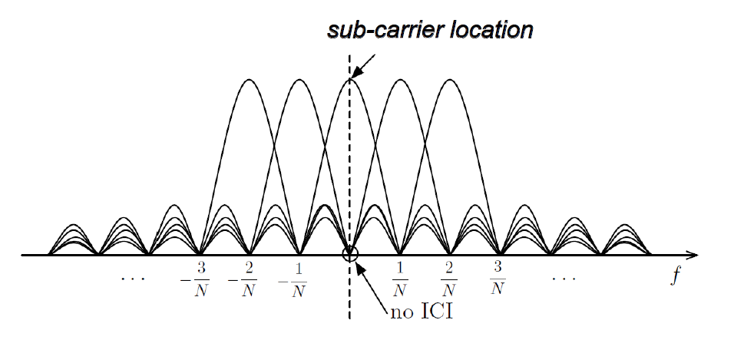
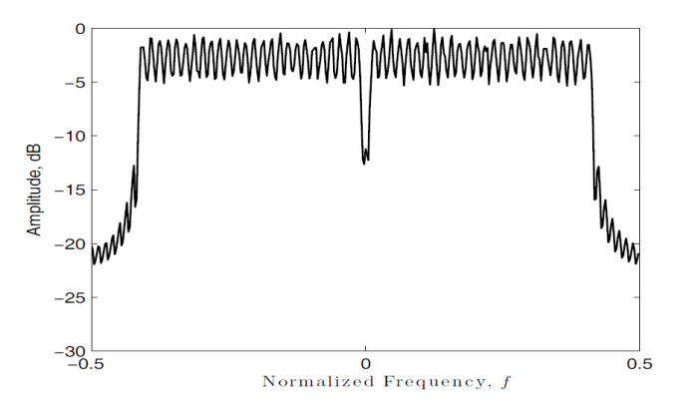
OFDM
OFDM is a multicarrier modulation scheme in which a high-rate data stream is split into multiple parallel low rate streams
The adjacent modulated sub-carriers are theoretically orthogonal and have no Inter carrier Interference (ICI).
OFDM signal is modulated using sub-carriers across frequency
Notes:
Then, We investigate the OFDM modulation and its features for Adaptive Radios.
Inter carrier Interference (ICI) refers that the other sub-carriers cause an interference to one sub-carrier at the sampling point.

Slide 13
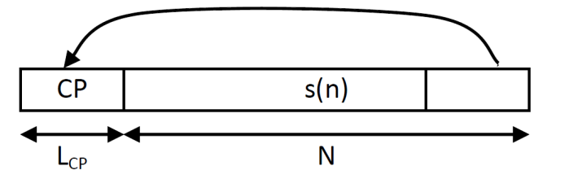
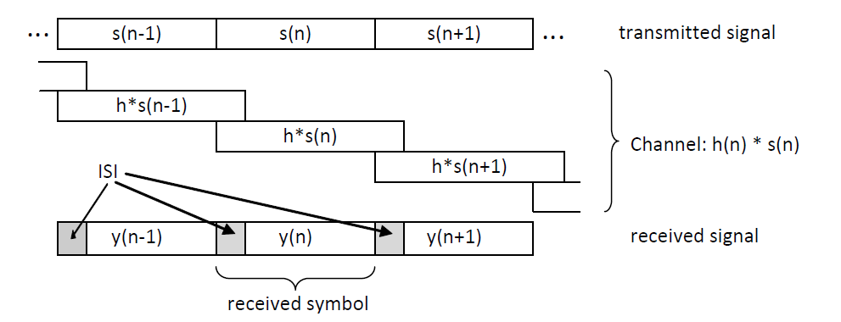
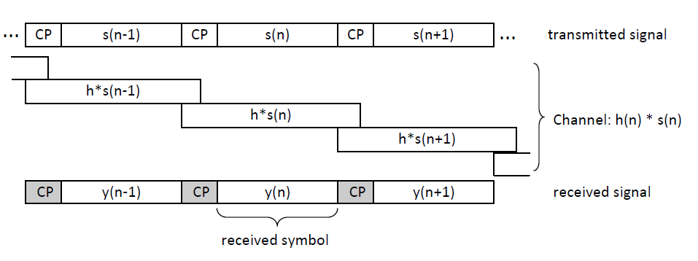
OFDM
A guard interval (or cyclic prefix (CP)), having a length of L_{CP} , is added before each OFDM symbol.
The length of CP must be longer than that of channel impulse response (CIR) to avoid Inter Symbol Interference (ISI).
Notes:
The first Fig. shows how the CP is added
Inter Symbol Interference (ISI) refers that OFDM symbol is interfered by the adjacent symbols.
The left fig. shows the ISI because of CIR while the righ Fig. illustrates how ISI is avoided thanks to CP.

Slide 14
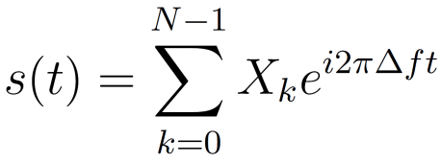
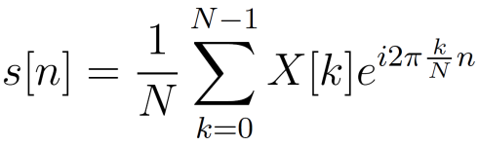
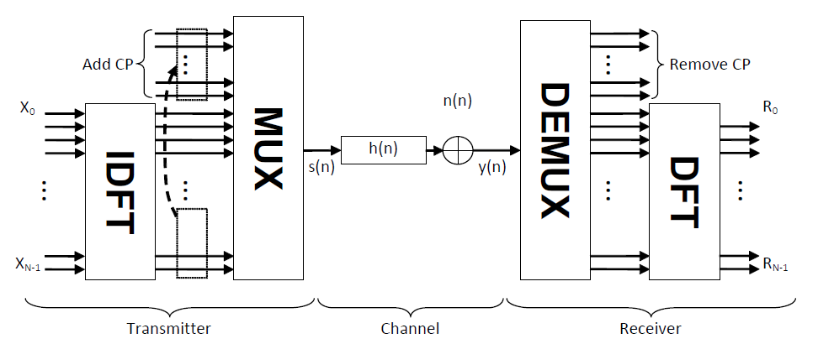
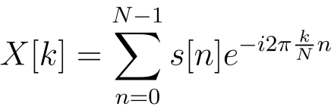
OFDM
An OFDM symbol signal can be expressed at baseband by a sum of modulated complex exponentials as:
OFDM symbol signal is modulated by an inverse N-point discrete Fourier transform (IDFT)
Inversely, the sampled OFDM symbol signal can be demodulated using discrete Fourier transform (DFT).

Slide 15

OFDM
Evaluating OFDM :
Spectrally efficient usage
Robustness against multipath propagation
Perfect cancellation of ISI and ICI thanks to CP
Robustness against fading thanks to splitting a data stream into several parallel low-rate streams
Easy implementation using fast Fourier transform (FFT)

Slide 16
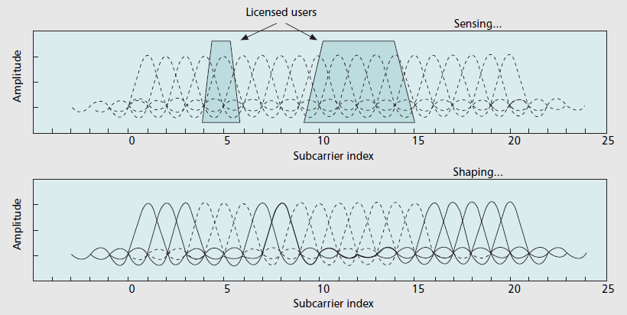
OFDM
Good fit for CR:
Performing spectrum sensing and awareness effectively
Doing spectrum shaping easily with Non-Contiguous OFDM (NC-OFDM)
Ability to change parameters for adaptation/ scalability
Notes:
The Fig shows how efficiently OFDM provides the flexibility for CR doing spectrum sensing and shaping
Using FFT senses the occupied spectrum of licensed user and only enable sub-carrier in idle spectrum to transmit.

Slide 17

OFDM
OFDM Synchonisation
Terminology
Timing offset(STO) refers to differences in correct sample index and the actual sample index of received sample that causes misaligned window to compute DFT for demodulation.
Coarse STO is to find the starting index of OFDM symbol inside the received OFDM symbol including CP.
Fine STO is to find the accurate index to obtain correct OFDM symbol’s samples to compute DFT for demodulation.

Slide 18
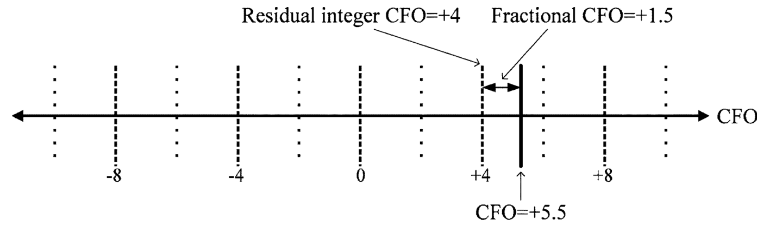
OFDM
OFDM Synchonisation
Terminology
Carrier frequency offset (CFO) refers to a difference in frequency between the receiver clock with respect to the ‘correct’ frequency of carriers in a transmitted OFDM symbol.
CFO is commonly normalized by the sub-carrier frequency. The integer CFO represents shifted subcarrier symbols in the frequency domain, while the fractional CFO causes the interference between subcarriers

Slide 19

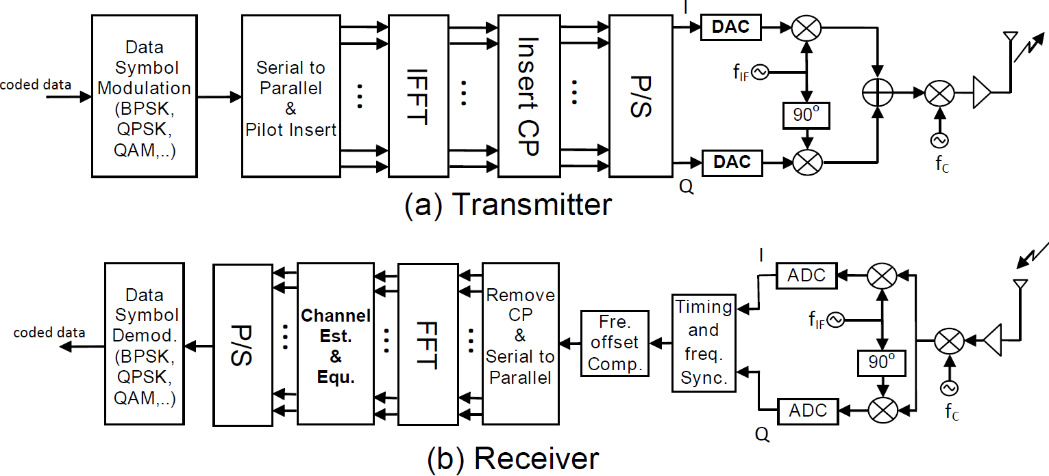
OFDM
OFDM Synchonisation
OFDM performance is very sensitive to synchronization.
Frequency offset causes inter-subcarrier interference(ICI)
Errors in timing syn. can lead to inter-symbol interference (ISI).
Notes:
OFDM has many advanced features, however, its can be achieved if the synchronisation in receiver performs perfectly.

Slide 20

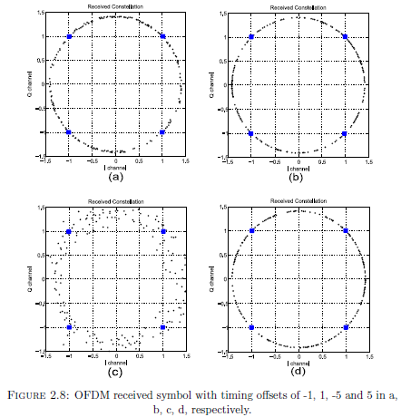
OFDM
OFDM Synchonisation
Timing offset refers to differences in correct sample index and the actual sample index of received sample that causes misaligned window to compute DFT for demodulation.
Actual sample index is earlier than correct sample index leading to subcarrier rotation.
Actual sample index is later than correct sample index resulting in ISI.
Notes:
If Actual sample index is earlier than correct sample index, Some samples of CP are taken to compute FFT, that leads to subcarrier rotation.
If Actual sample index is later than correct sample index, Some samples of next OFDM symbol are taken to compute FFT, that results in ISI.

Slide 21
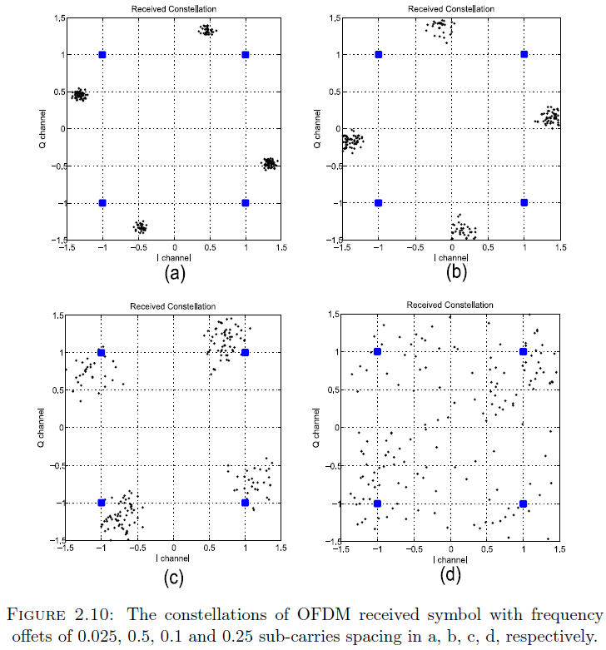
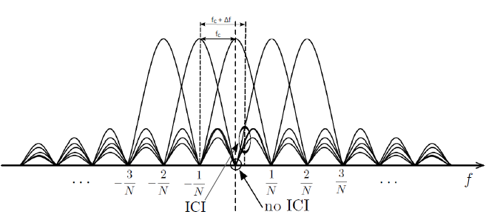
OFDM
OFDM Synchonisation
Frequency offset introduces the loss of orthogonality between the sub-symbols, significantly degrades system performance
Notes:
As can be seen, OFDM performance is sensitive to even small frequency offsets. The effect of CFO causes dispersion, similarly to AWGN, and also phase rotation in the QPSK constellation demodulated from OFDM symbol

Slide 22

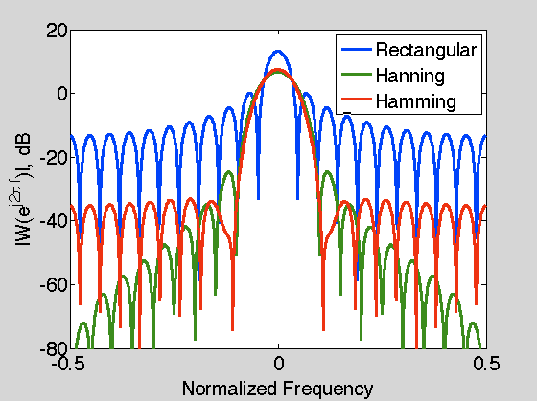
OFDM
OFDM has large spectral leakage
Applying window filter can reduce side lobes of OFDM signals
Notes:
One drawback of OFDM is spectral leakage due to the summation of sinusoidal subcarriers windowed by a rectangular function.
Some recent OFDM-based standards demand very strict requirements on spectral leakage to avoid inter-channel interference between adjacent transmission channels.
This raises a significant challenge in terms of how to shape the spectrum of the OFDM signal.
The Fig. shows the spectrum leakage of some window filter applied for ODFM symbols. Using Rectangular window is equivalent to transmitting unfiltered OFDM symbol.

Slide 23


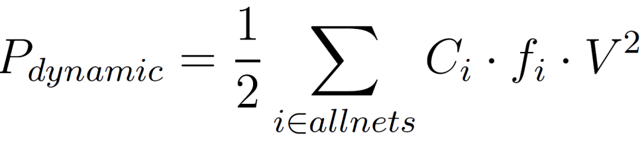
Field Programable Gate Array (FPGA)
FPGAs are an attractive platform for digital circuit implementation in particularly for CR research.
High performance
Low power
Flexibility
Power Consumption on FPGA:
P_{total} = P_{devicestatic} + P_{designstatic} + P_{dynamic}
Dynamic power dissipation :
Notes:
Fast time-to-market, flexible reconfiguration, and improving performance make FPGAs an attractive platform for digital circuit implementation in particularly for CR research.
where Pdynamic represents average power consumption, Ci is the capacitance of a net, fi is the average transition rate (switching activity) of corresponding net, and V is the voltage supply.
From this Formula, some low-power strategies would be proposed based on C, f, V.

Slide 24

Field Programable Gate Array (FPGA)
Using XPower Estimator to estimate power at early stage of design flow (XPE);
XPower Analyzer (XPA) to analyse the power dissipation of systems implemented on Xilinx FPGA devices after Place & Route
Power can be reduced by:
Reduce computational complexity
Reduce buffering data between functional modules
Reduce switching activities by latching registers with enable signals

Slide 25
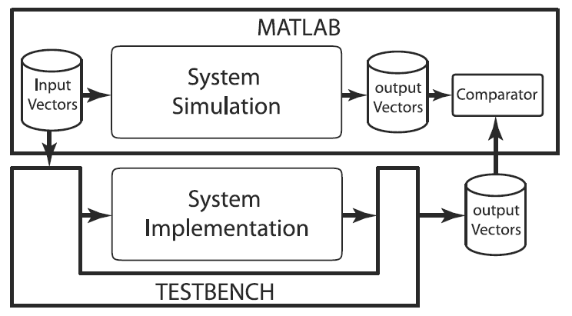
Field Programable Gate Array (FPGA)
System Verification for FPGA Implementation
Notes:
We verified the correctness and performance of our implemented system illustrated in Figure.
The overall framework evaluates our hardware design against a MATLAB “golden reference".
The MATLAB prototype serves to provide the implementation definition as well as providing a source for both random
and non-random test vectors for each hardware component.
Common input vectors are used to perform OFDM modulation in both implementations.
Testbench scripts send the input vectors from a database to the implemented system.
Moreover, testbench scripts are also used to monitor the signals generated by the implementation and store them to a database as output vectors. These output vectors are then read into MATLAB for comparison against the corresponding vectors generated by golden reference.

Slide 26
OUTLINE
Research Introduction
Background Literature
Research Contributions
Multiplierless Correlator Design
OFDM Timing Synchronisation
OFDM IFO Estimation Method
Spectrum Efficient Shaping Method
Architecture for Multi-Standard CRs
Conclusions and Future Work

Slide 27
Research Contribution on
Multiplierless Correlator Design

Slide 28

Multiplierless Correlator Design
Correlation commonly to perform synchronisation
Cross-Cor better than Auto-Cor, come at hardware cost
Multiplierless-Cor reduces complexity, power
Notes:
Correlation is commonly used to perform synchronisation in OFDM systems
The accuracy of cross-correlation is better than that of auto-correlation, however, comes at significant hardware cost.
Multiplierless Correlator reduces the complexity as well as power consumption.

Slide 29
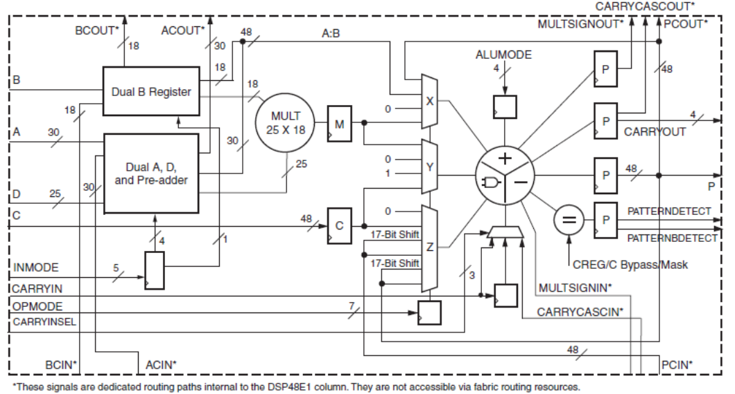
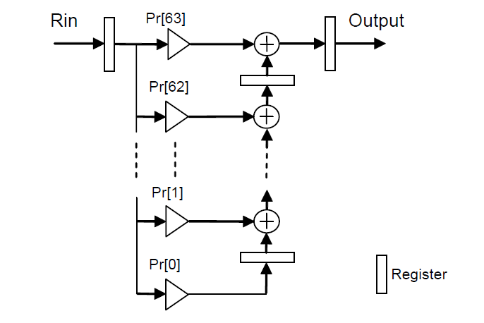
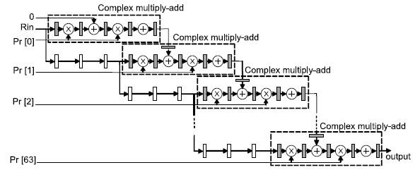
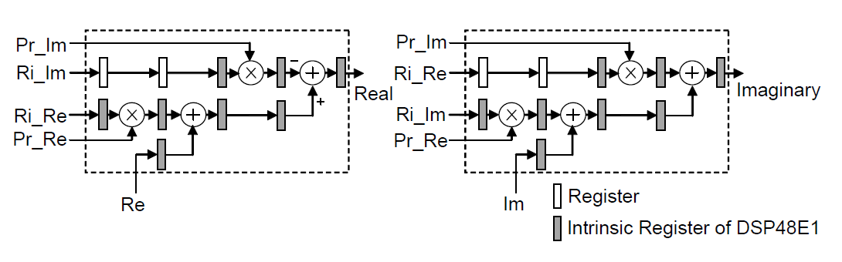
Multiplierless Correlator Design
DSP48 Block Correlation
Transpose Direct Form of FIR
Notes:
The multiplier-based correlation is implemented as a normal way. It uses DSP block on FPGA to perform multiply operator.
This fig shows the diagram of DSP48 Blocks. This had a flexible structure to implement mathematic operator in particularly in implementing multiply-add operator.
This Fig. shows the Transpose Direct Form of FIR for performing Correlation.
This Fig. shows detail pipeline structure of the complex number multiply-add based on DSP48.
This Fig. illustrate the structure of DSP48-based correlation. There are some register needed for pipeline structure to improve the performance.

Slide 30

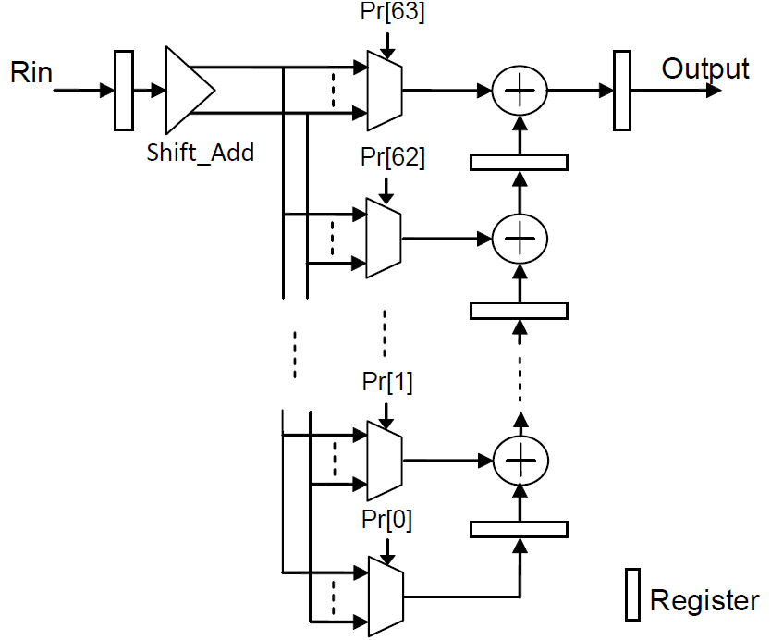
Multiplierless Correlator Design
Coefficients are rounded in the form of summed powers of two.
Shift, Add instead of multiplying by coefficients.
Four alternative multiplierless Cor. using 4 coefficient sets.
Quantisation of 0.125, 0.25, 0.5, and 1 corresponding to using 4, 3, 2, 1 bits .
Compare the cost, performance with multiplier-based correlators
Notes:
The principle of multiplierless correlators is to represent the coefficients and round them in the form of summed powers of two. Hence, a shift and add are performed instead of using multipliers.
Four alternative multiplierless correlators are implemented using four coefficient sets with an increasing degree of rounding.
The coefficient sets are found by quantising the 64 normalised preamble samples with quantisations of 1, 0.5, 0.25, and 0.125
Compare the cost and performance and evaluate against multiplier-based correlators.

Slide 31
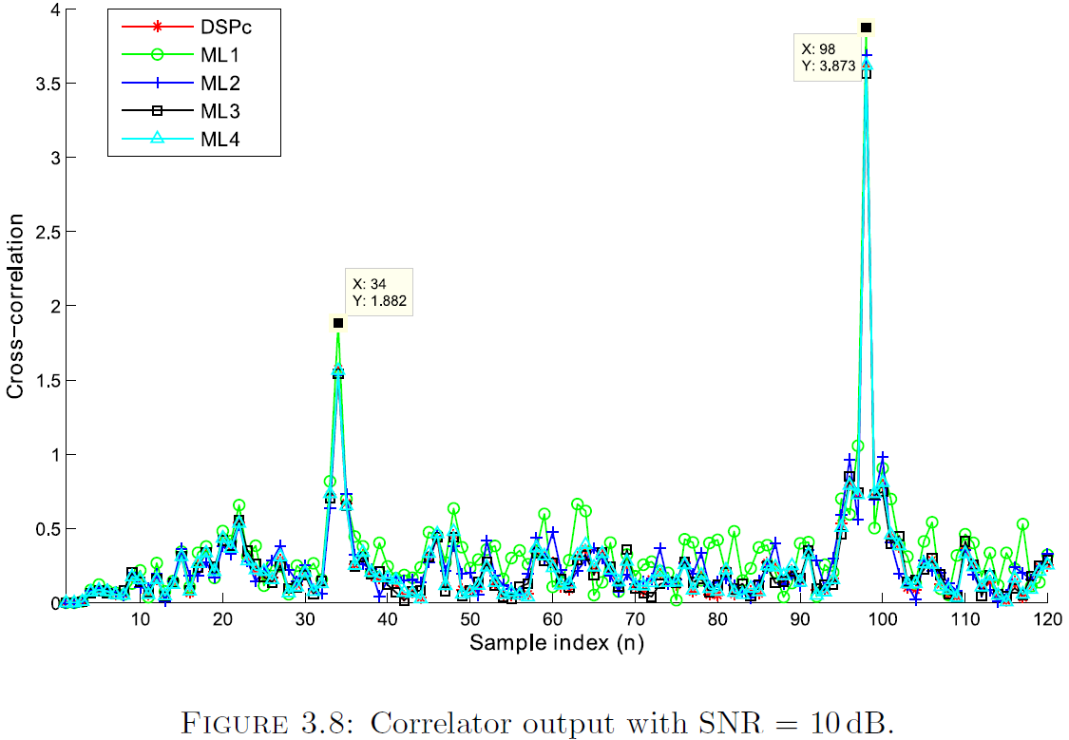
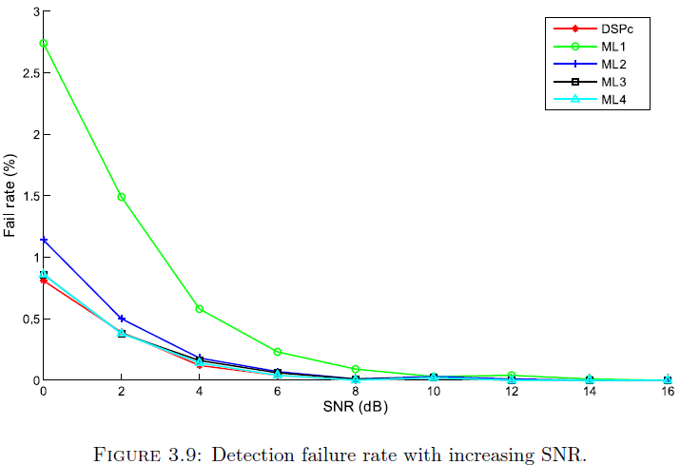
Multiplierless Correlator Design
Multiplierless Correlation Results
The correlators are used for OFDM synchronisation
DSP_Cor: DSP48 based correlator
ML1_Cor, …, ML4_Cor: Multiplierless correlator with quatisation of 1, 0.5, 0.25, 0.125, respectively
Notes:
The correlators are applied to OFDM synchronisation to evaluate the accuracy via the failure rate of frame synchronisation.
Be able to accurately detect the start of frame even in low SNR conditions.
Failure rate depend on the quatisation, more bits is better.
For SNRs above 4 dB, the failure rates of ML2_Cor, ML3_Cor, ML4_Cor and DSP_Cor differ less than 0.05% from each other.
Sacrificing accuracy by using multiplierless cross-correlation is feasible and has negligible impact on synchronisation accuracy.

Slide 32
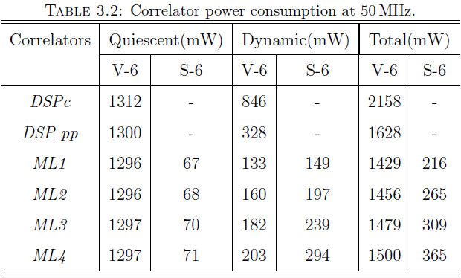
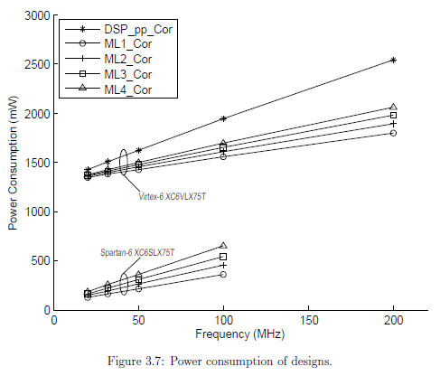

Multiplierless Correlator Design
Multiplierless Correlation Results
Sufficient DSP Blocks on large Virtex but not Spartan
ML Cor save over 85% power compared to a DSP based design
This work has published in IEEE TVLSI
Notes:
Multipllierless correlation consumes less power than DSP48 based correlation.
Moreover, low-cost devices such as the Xilinx Spartan-6 do not include sufficient DSP48 blocks for multiplier-based correlation.
Multiplierless correlation on a Spartan-6 can save over 85% power compared to a DSP-based design on a Virtex-6 FPGA.

Slide 33
Research Contribution on
OFDM Timing Synchronisation

Slide 34
OFDM Timing Synchronisation
Some research has focussed on improving OFDM synchronisation performance and accuracy based on the CP or the preamble symbols of OFDM frame.
Short training symbol
Long training symbol
CP
64
64
64
64
CP
128
128
L
N
Downlink Preamble of IEEE 802.16d
Auto-correlation or Cross-correlation on the preamble symbols could be used to achieve the synchronisation.
Notes:
Fig shows the Preamble of IEEE 802.16d, including 2 symbols: short symbol contains 4 period of 64 samples; long symbol has 2 periodic half with length of 128 samples.
That would be chosen to applied investigated method for synchronisation.
Let’s consider some previous works based on two kind of correlation for synchronisation.

Slide 35
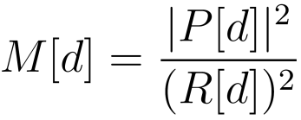
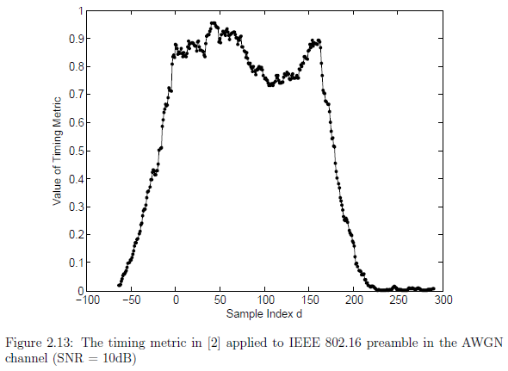
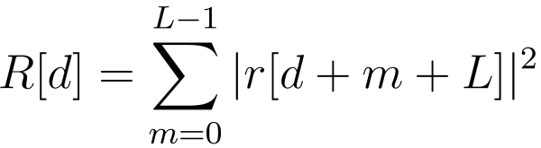
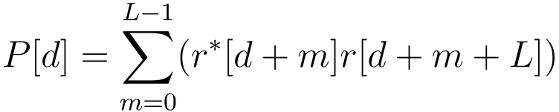

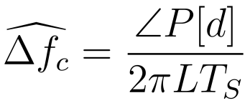
OFDM Timing Synchronisation
The autocorrelation-based method is commonly preferred for implementing synchronisation because of its low computation requirements.
The fractional CFO is estimated
The angle of P[d] within the range -π to π. So the fractional CFO estimation has a limitation
Notes:
The metric computes the autocorrelation of received samples. When the preamble is being received, because of periodic feature of preamble, the metric will create the plateau.
The accuracy of this method is not good enough to find the correct starting sample of FFT window. It is just used to estimated the Coarse STO and require the supplementary process to determine fine STO.
I would like to call this is conventional method.

Slide 36
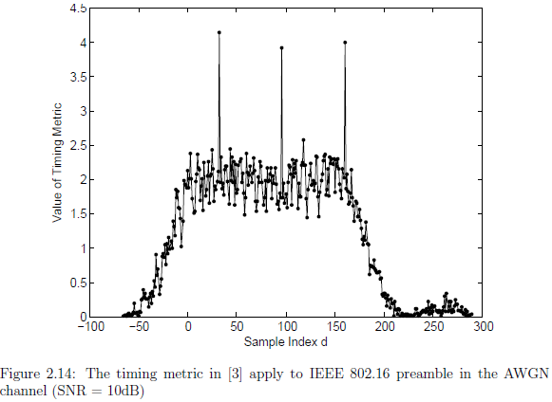
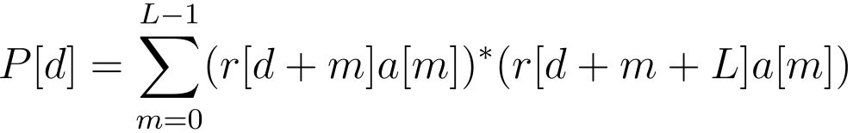
OFDM Timing Synchronisation
Performing Cross-correlation between received preamble and known transmitted preamble can accurately determine the start of frame even at low SNRs.
However cross-correlation operation requires complex computation
Notes:
When the preamble is being received, the received samples match with transmitted samples of preamble, the metric will introduce the peaks.
This method is proposed by Kishore and Reddy in [3].

Slide 37
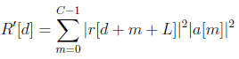
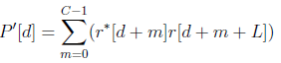
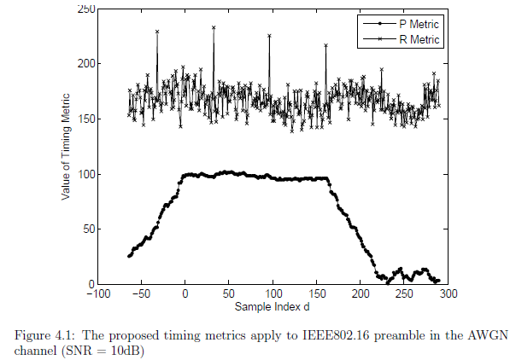
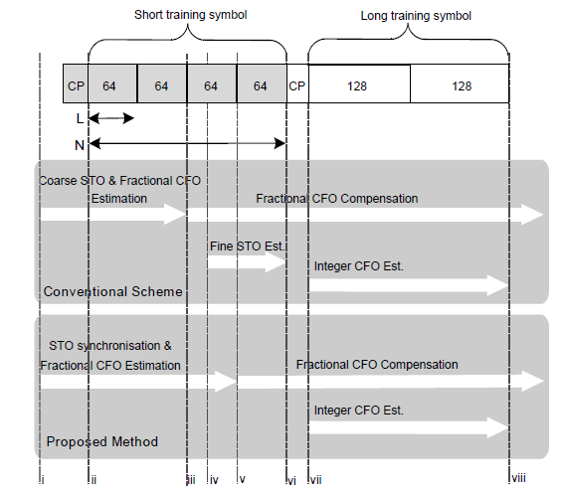
OFDM Timing Synchronisation
New timing metrics take advantage of preamble characteristics (periodic, energy distribution)
Notes:
Considering the limitations of previous work, we propose new timing metrics to take advantages of preamble characteristics such as period and energy distribution.
The proposed metric is as formula,
The difference of R’ metric from R metric of conventional method is that the R’ takes into account the energy distribution of known transmitted preamble symbol. That cause a peak to determine the starting point accurately.
This Fig. shows the scheme flow of proposed method in comparison to conventional method.
The proposed method does not need the fine STO process, So the metric can be computed with more samples, M can be chosen as 128 samples, So the accuracy is improved.

Slide 38
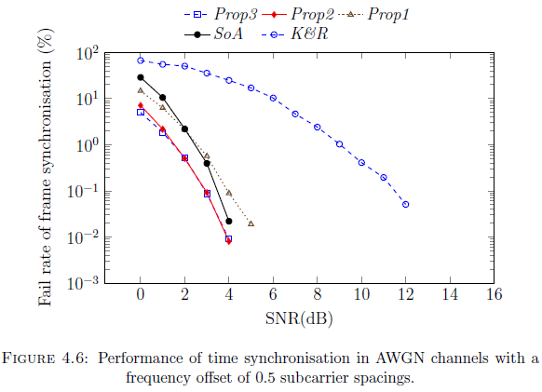
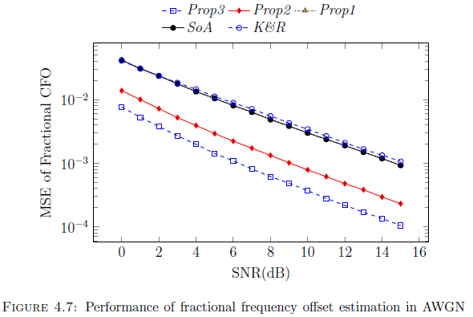
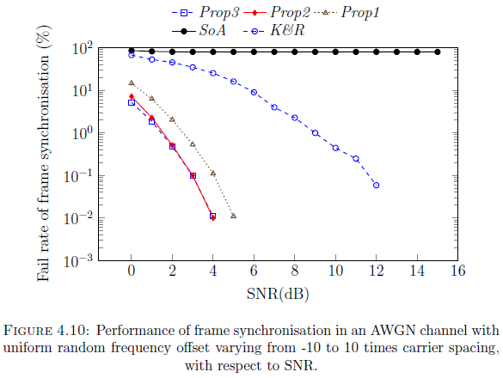
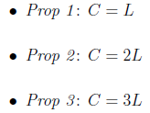
OFDM Timing Synchronisation
Notes:
As can be seen, the performance of frame synchronisation using this proposed method is as good as conventional schemes.
Interestingly, the fractional CFO estimation of the proposed method is much improved in comparison to the two other methods.
The performance of frame synchronisation in proposed method robust to large CFO while conventional method does not.
The proposed method reduces the amount of complex computation compared to Kishore and Reddy method.

Slide 39
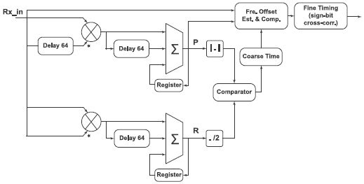
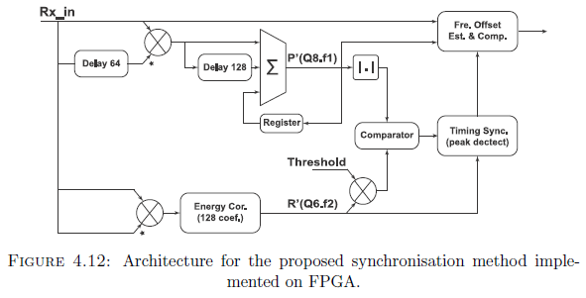
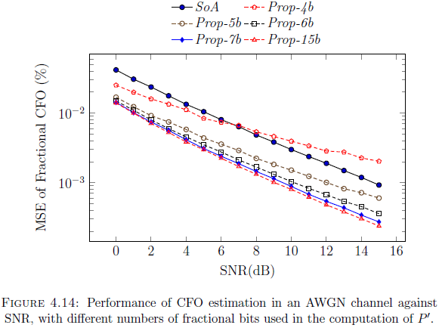
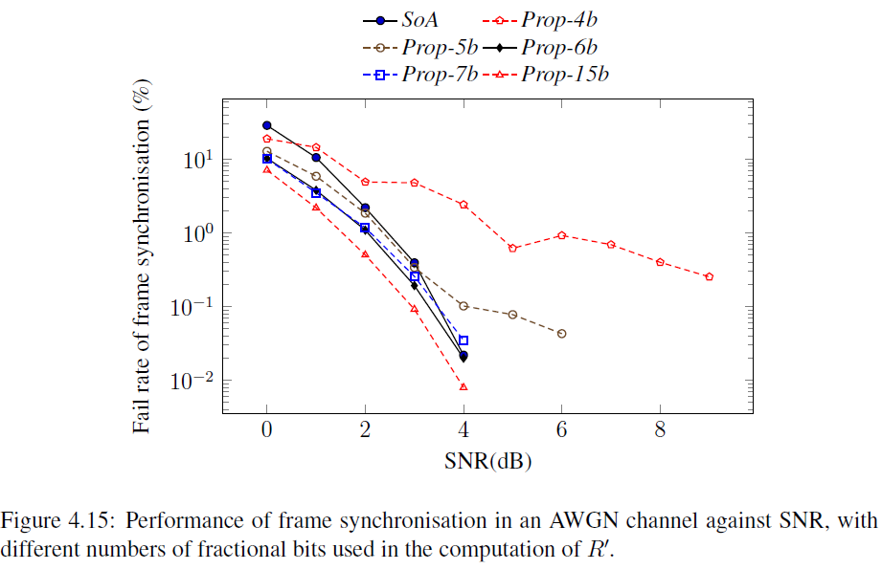
OFDM Timing Synchronisation
The effects of reducing the number of bits used to represent P' and R'
P' has fixed point format Q8.f1
R' has fixed point format Q6.f2.
Notes:
The effects of reducing the number of bits used to represent these fractional components of P' and R'
P' has fixed point format Q8.f1 and R' has fixed point format Q6.f2.
f1 and f2 be the number of bits representing the fractional part for computing P' and R' respectively.

Slide 40
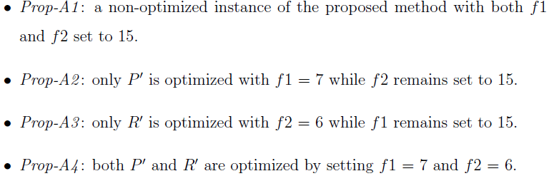
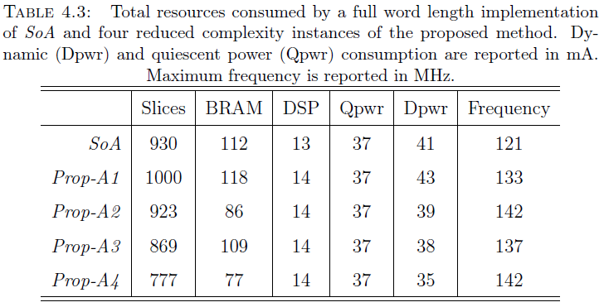
OFDM Timing Synchronisation
Prop-A4 achieves a reduction of 16.4%, 31.2%, and 14.6% in the number of occupied slices, BRAMs, and Dpwr compared to SoA
Notes:
The preceding results are now used to define four alternative implementations of the proposed method to compare against the state-of-the-art method which uses full length Q1.15 arithmetic. These alternatives are namely:
From the table, it is evident that reducing word length can yield a significant reduction in both hardware requirement and power consumption.
The fully optimized alternative, Prop-A4, achieves a reduction of 16.4%, 31.2%, and 14.6% in the number of occupied slices, BRAMs,
and in dynamic power consumption, when compared to SoA.

Slide 41
OFDM Timing Synchronisation
Performance results through simulation demonstrate good performance and robustness to large CFO.
Complexity less than cross-correlation makes proposed method more suitable for low-power hardware implementation.
This work is published in Circuits, Systems, and Signal Processing
Notes:
In conclusion, the proposed method demonstrates good performance and the robustness against large CFO.
Complexity of the timing metric is much less than that of cross-correlation-based methods, making the proposed method more suitable for hardware implementation.

Slide 42
Research Contribution on
OFDM IFO Estimation Method

Slide 43




OFDM IFO Estimation Method
Y : received symbols
X : pilot sympols
H: channel response
W: White Noise
Notes:
Previously, robust OFDM timing synchronisation was explored, leading to a proposed method that is able to perform well even in the case of large fractional CFO.
However, the CFO estimation of that method was only estimate the fractional CFO rather than large integer CFO that can occur as a result of the Doppler Eect and/or due to local oscillator instabilities.
CFO is usually normalised by subcarrier spacing and divided into an integer frequency oset (IFO) part, which is a whole multiple of subcarrier spacings, and a remainder which
is referred to as fractional frequency oset (FFO).
IFO causes a circular shift of the subcarrier in the frequency domain.
Cross Correlation in (5.3) consumes a huge computational cost, is not practical for hardware implementation.

Slide 44



OFDM IFO Estimation Method
Subset of possible IFO values is determined
Assume -14 < IFO < 18 =>
Resource sharing folded architecture to reduce the hardware cost
Spreading the chosen subset of pilots (indices that are multiples of 4)
Multiplierless correlation to enhance the accuracy of estimation
Notes:
With assumption, the RF front end can provide CFO stability in a range from -14 to +18 subcarrier spacings.
The subset of possible IFO values is determined relied upon fractional CFO estimation.
A resource sharing folded architecture is designed to signicantly reduce the hardware cost.
Evidently, as the number of pilots increases results in greater robustness to noise and leads to considerable hardware overhead, especially with a large number of pilots, like 802.16.
But, the performance improvement reaches a plateau.
Therefore, I make use of only a subset of pilots, while maintaining estimation accuracy as much as possible.
Then, by spreading the chosen subset of pilots carefully in the time domain, it becomes possible to design a resource-sharing
architecture for computing the cross-correlation, hence reducing area and power consumption.
When the proposed method is applied to 802.16 offset estimation, the pilots used for the IFO computation are selected at subcarrier indices that are multiples of 4, leading to a natural four-fold resource sharing
Sign-bit cross-correlation is typically used, as it can signicantly reduce computational complexity, it also leads to reduced performance, especially in the case of frequency selective channels.
Instead of using Sign-bit correlation, I employ multiplierless correlation to enhance the accuracy of estimation by investigating the trade-off between cost and accuracy when reducing the word length of parameters P(4k).

Slide 45



OFDM IFO Estimation Method

Slide 46


OFDM IFO Estimation Method
The proposed method (Prop) compared to methods by Park et. al. [100] (PCH), Shim and You [43] (SY) and Morelli and Moretti [44] (MM)
Sign-bit correlation versions of the above PCH_sb, SY_sb, and MM_sb
Use 50 spread pilots with indices that are multiples of 4 compared to PCH using 50 pilots (PCH 50)
Notes:
The performance of the proposed method, denoted Prop, is evaluated in comparison to the theoretical performance of state of the art methods by Park et. al. [100], Shim and You [43] and Morelli and Moretti [44], denoted PCH, SY and MM, respectively.
The theoretical performance is computed with full precision using full multiplication.
The full multiplication results shown here are better than those achievable in practice, and thus can be considered as upper performance bounds. For more realistic data, we also provide results from sign-bit correlation versions of the above, denoted PCH_sb, SY_sb, and MM_sb, respectively.
The proposed method, evaluated against these, uses 50 spread pilots with indices that are multiples of 4.
For the sake of comparison, an additional implementation of PCH is reported which, like the proposed method, uses only 50 pilots, but
which are placed continuously rather than being spread. This is denoted PCH 50.
Figures plot performance results for all methods in an AWGN channel, with and without RTO respectively, and reveal that the proposed method generally performs well, especially at higher SNRs.

Slide 47


OFDM IFO Estimation Method
The proposed method performs well, especially at higher SNRs.

Slide 48



OFDM IFO Estimation Method
The complexity dependent on the word length of the correlation computation.
Evaluation for fractional bits: 1, 2, 7, 15 bits denoted Prop_1b, Prop_2b, Prop_7b, Prop_15b,
Notes:
The complexity of this approach is dependent on the wordlength chosen for the correlation computation.
We now investigate how wordlength affects the performance of the proposed implementation, again compared to the theoretical bound, PCH, as well as to the performance of a conventional sign-bit implementation, PCH sb.
We denote wordlength using the notation Q1:f , meaning a single integer bit and f fractional bits.
Evaluations are performed for f of 1, 2, 7, and 15 bits. These results will be plotted in the following Figure with the labels Prop 1b, Prop 2b, Prop 7b, and Prop 15b, respectively.

Slide 49
OFDM IFO Estimation Method
A low power, low resource utilisation implementation of IFO estimation
Robust IFO Est.: relax analogue RF constraints, lead to reduced cost.
Four-fold resource sharing architecture to reduce hardware cost;
Multiplierless Cor. with optimised wordlength improve accuracy
Dynamic power consumption is reduced by 78%;
Better estimation in both AWGN and frequency selective channels
This work is accepted for IEEE TVLSI
Notes:
A technique is proposed for efficient implementation of IFO estimation for a low power and low resource utilisation.
Since IFO estimation contributes sigfinicantly to the complexity of a robust synchroniser design, this work is important for multi-standard radios, or applications where significant frequency variation is expected.
Robust IFO estimation allows for relaxed analogue RF constraints, leading to reduced cost.
The proposed implementation makes use of a four-fold resource sharing architecture to significantly reduce hardware cost, while multiplierless correlation with optimised wordlength is used to improve estimation accuracy in comparison to a conventional implementation approach using sign-bit correlation.
The method is shown to perform as well as current state-of-the-art methods that employ multiplier-based correlation, and yet with significantly improved power and resource requirements.
Dynamic power consumption is reduced by 78% over even a sign-bit version of the conventional approach.
It offers better estimation performance in both AWGN and frequency selective channels.

Slide 50
Research Contribution on
Spectrum Efficient Shaping Method

Slide 51
Spectrum Efficient Shaping Method
OFDM signals cause large side slobe <> CRs demand small spectral leakage.
Lead to a reduction in the effective timing guard
Recent OFDM-based Systems requires stringent SEMs
SEMs: spectral emission masks
Notes:
In this part, we will talk about the OFDM spectral leakage challenge for OFDM based CRs.
OFDM signals typically cause large amounts of spectral leakage.
While CRs demand a shaped spectrum within the allocated channel in order to reuse free spectral bands without causing ICI to other users occupying adjacent bands.
Some recent OFDM-based standards are defined with the requirements on spectral leakage that are extremely stringent in an effort to avoid ICI.
Spectral leakage filtering may cause some effects on transmitted signals that lead to a reduction in the effective timing guard.
So, the implementations of spectral leakage filtering need to be able to take into account the parameters of the OFDM signal and channel characteristics to avoid causing negative effects on the transmitted signal such as distortion and ISI.
In this chapter, a novel method that embeds baseband filtering within a cognitive radio (CR) architecture, is proposed.
The method can adaptively change filter performance according to the transmission power to reduce computational cost while guaranteeing that the emission spectrum
remains smaller than the allowed spectral leakage.
The method is able to meet the specification for the most stringent 802.11p and 802.11af SEM.
The method, performed at baseband, relaxes otherwise strict RF front-end requirements.
This allows the RF subsystem to be implemented using much less stringent 802.11a designs, which can significantly reduce total cost.

Slide 52
Spectrum Efficient Shaping Method
Novel method for baseband filtering within CR architecture
Adaptively change filtering according to the transmission power
Meet the specifications of 802.11p, 802.11af SEMs
Perform at baseband, relaxes RF front-end requirements, reduce total system cost
SEMs: spectral emission masks
Notes:
A novel method is proposed to embed baseband filtering within a cognitive radio (CR) architecture,
The method can adaptively change filter performance according to the transmission power to reduce computational cost while guaranteeing that the emission spectrum
remains smaller than the allowed spectral leakage.
The method is able to meet the specification for the most stringent 802.11p and 802.11af SEM.
The method, performed at baseband, relaxes otherwise strict RF front-end requirements.
This allows the RF subsystem to be implemented using much less stringent 802.11a designs, which can significantly reduce total cost.

Slide 53



Spectrum Efficient Shaping Method
802.11p defined for vehicular channels
Reduced bandwidth => higher quality factor
Reduced sampling => narrower freq. guard
Larger delay spread ( 600 ns)
802.11af defined for reuse white space in the UHF band
55 dB attenuation
Delay spread is less than 1 us
Notes:
802.11p is defined for vehicular channels.
First, reducing bandwidth requires a higher quality factor front-end filter circuit for the higher frequency carrier compared to 802.11a.
Second, Given the reduced sampling frequency, this leads to the absolute frequency guard being correspondingly narrower.
Third, it experiences a larger delay spread than WLAN. The 90% largest delay spread is near 600 ns.
802.11af is defined to reuse white space in the UHF band, with three basic channel units (BCUs) of 6 MHz, 7 MHz, and 8 MHz.
FCC rules mandate a very strict SEM to avoid ICI on the adjacent channels of primary users in the UHF band.
For 6MHz channels, the signal transmitted by TVBDs shall maintain at least 55 dB attenuation at the edge of the channel, which is signicantly higher than the requirement of the parent 802.11ac standard.
In the 802.11af channel, the measured delay spread is less than 1 us, which is equivalent to the duration of 6 samples in the CP.
Any spectral leakage filtering necessary to meet the stringent SEM specification must not encroach further than this into the guard time.

Slide 54






Spectrum Efficient Shaping Method
Pulse Shaping & FIR Filtering

Slide 55


Spectrum Efficient Shaping Method
Pulse Shaping & FIR Filtering

Slide 56
Spectrum Efficient Shaping Method
Pulse shaping with small roll-off factors; Guard interval not long enough for FIR filtering cancel image spectrum
Pulse shaping with large roll-off factors with wider frequency guard, significant side lobe compression
Wider frequency guard extends the required transition band => a shorter FIR filter
=> Demand a frequency guard extension technique
Notes:
In a conventional approach, pulse shaping is only employed with small roll-off factors because large roll-off factors reduces the effective guard interval.
Given the narrow frequency guard and the amount left after accounting for the effects of CIR and matching filters, and pulse shaping, under such constraints is unable to cancel the
image spectrum by using FIR filter even if the entire guard interval was to be used.
New method takes a different approach. Instead of using a large proportion of the guard interval for FIR filtering, we allow the pulse shaping to occupy a significant portion of the guard space, with large roll-o factors.
To obtain the significant spectral leakage reduction necessary, the frequency guard needs to be increased.
It thus involves introducing a frequency guard extension technique.
Then, given a wider frequency guard extends the required transition band for FIR filtering, which means a shorter FIR filter is able to attenuate the image spectrum.

Slide 57

Spectrum Efficient Shaping Method
Increase IFFT Length, Sampling (M times);
Zero-padded in allocation Vector (NC-OFDM)
Pulse shaping is applied with large roll-off factor
L-fold inter and FIR filter remove the image spectrum.
Notes:
The method thus involves three steps:
First, Frequency guard is extended. The IFFT length is multiplied by a factor M, and the sampling frequency similarly increased by a factor M, to maintain the same subcarrier spacing.
Given this, the allocation vector is formed to add data symbols at lower subcarriers that are the same as those in the original IFFT, while the remaining subcarriers are zero-padded.
Next, pulse shaping is applied with large roll-off factor in the normal way, to meet the given SEM constraint.
Finally, L-fold interpolation and FIR filter are used to allow simple filtering to remove the image spectrum.
In addition, the proposed architecture allows the transmitter to dynamically reduce the degree of filtering when transmission power is reduced: since transmit power reduction naturally reduces ICI.
This is particularly important for lower power operating modes in which a lower sampling frequency, less filtering complexity, and reduced transmission amplitude all contribute to power savings.

Slide 58

Spectrum Efficient Shaping Method
Notes:
In order to provide the flexibility for dynamic shaping spectral leakage, the processing modules (i.e. IFFT+CPInsert, Pulseshaping, L-FoldInter&FIR) are implemented with the ability to switch operating mode at run time.
This in turn involves an increase in hardware resources compared to a fixed implementation.
Table compares the hardware usage of the modules for the proposed flexible method and fixed architecture.
FlexArch requires a remarkable further amount of hardware resource compared to the FixedArch.
However, it should be noted that the additional computation needed for signal processing in the baseband (which uses low cost, low power components), can be more than compensated for by relaxing the specification of the RF front-end design, since the analogue filtering requirements are so much less strict.

Slide 59


Spectrum Efficient Shaping Method
Configuration and Performance Evaluation for 802.11p
Prop1: double IFFT size (M = 2); 4-fold interpolation (L = 4); Fs=80 MHz.
=> GI usage: 500 ns for PS; 500ns for FIR and match filter; 600ns for CIR
Prop2: 4 x IFFT size (M = 4); 2-fold interpolation (L = 2); Fs=80 MHz.
=> GI usage: 500 ns for PS; 300ns for FIR and match filter; 800ns for CIR
Notes:
Guard interval of 802.11 p is 1600 ns and CIR < 600ns.
Prop1 doubles the size of the IFFT, i.e., M = 2, which means doubling the
sampling frequency to extend the frequency guard, after which 4-fold interpolation,
i.e., L0 = 4, is required to obtain a sampling frequency of 80 MHz.
Prop2 quadruples the size of the IFFT, i.e., M = 4; Then applies 2-fold interpolation,
i.e., L0 = 2 to achieve the 80MHz sampling frequency.
Prop2 has a wider frequency guard compared to Prop1 and thus its FIR filter only requires a short length to cancel the image spectrum. Additional remaining effective guard interval of 200 ns is reserved.

Slide 60


Spectrum Efficient Shaping Method
Configuration and Performance Evaluation for 802.11af
BW = 6MHz: 4xIFFT size (M = 4); 2-fold interpolation (L = 2); Fs = 48 MHz.
=> GI usage: 3.75 ns for PS; 1.12ns for FIR and match filter; 1.13ns for CIR
Notes:
6MHz bandwidth channel is applied that have GI of 6ns and CIR < 1ns.
We further investigate on spectral efficiency of proposed method relied upon given a flexible allocation of subcarriers. Adjusting the number of occupied subcarriers until the transmission spectrum fits within the 802.11af SEM.
The results demonstrate that the proposed CR architecture can not only meet the stringent SEM requirement of 802.11af but could also be used to enhance spectral efficiency beyond that.
Compared to the approach of trimming o edge carriers needed by an equivalent transmission power conventional system in order to satisfy the SEM, the proposed approach to CR spectrum shaping increases spectral efficiency by 32%.

Slide 61
Spectrum Efficient Shaping Method
CR architecture for shaping spectral leakage at baseband
Meet stringent SEMs of 802.11p, 802.11af
Achieve spectral efficiency for reuse of TVWS in 802.11af by 32%,
Ability to adaptively change the degree of spectral leakage filtering in response to transmission power
This work is reported in VTC 2014 and extended for DSP journal
Notes:
For this contribution, we can conclude that shaping the OFDM leakage spectrum has been investigated at baseband within a CR architecture, in order to meet stringent spectral emission mask (SEM) requirements.
In particular, this research considers two relatively new standards, 802.11p and 802.11af, which are defined for the physical layer and largely based upon existing standards.
Simulations show that the proposed architecture can meet the specification of the four 802.11p classes A to D, as well as the stringent FCC-imposed SEM for 802.11af in the UHF band.
The proposed method is also shown able to improve the achievable spectral efficiency for reuse of Television White Spaces in the 802.11af standard by 32%, given equivalent transmission power, compared to
conventional approaches which need to drop the outermost subcarriers in order to meet SEM requirements.
In addition, the architecture has the ability to adaptively change the degree of spectral leakage filtering in response to transmission power.
The computation of filtering can be reduced when transmission power is low, but when transmission power is high, it is able to extend to meet the strict SEM specification of both 802.11p and 802.11af. Furthermore, the architecture is capable of adjusting clock rate, bandwidth, and frequency band on a symbol-by-symbol basis, in order to implement an agile CR solution.

Slide 62
Research Contribution on
Architecture for Multi-Standard CRs

Slide 63
Architecture for Multi-Standard CRs
MSCR for the demand: higher bandwidth, efficient spectrum usage
FPGAs: ideal platform for flexibility, performance, and efficiency.
Combining partial reconfiguration (PR) with parameterised modules offers flexibility while minimising reconfiguration time.
The reconfiguration is required to operate fast enough
Notes:
Multi-Standard CRs support multiple bands and adapt operation according to environmental conditions are becoming more attractive as the demand for higher bandwidth and more efficient spectrum use increases.
Traditional implementations in custom ASICs cannot support such flexibility, with standards changing at a faster pace, while software implementations of baseband communications fail to achieve the performance required. Hence, FPGAs offer an ideal platform bringing together flexibility, performance, and efficiency.
In this chapter, we show how we can incorporate our contributions in previous chapters into a flexible architecture for multi-standard cognitive radios (MSCR).
We show that combining partial reconfiguration (PR) with parameterised modules offers flexibility while minimising reconfiguration time.
When the system adapts to a new condition (i.e., switching the operating standard), a reconfiguration operation is performed which may pause or suspend data processing for the duration of the reconfiguration.
Received packets of data may therefore be lost.
The reconfiguration is required to operate fast enough that the input data buffered during reconfiguration does not overflow the buffer, leading to entire packets of data being dropped.
Even though there are higher-level protocols available to manage the retransmission of lost or dropped packets, performing these mechanisms is wasteful and may significantly increase the cost in terms of computation and power consumption.

Slide 64
Architecture for Multi-Standard CRs
Powerful general purpose processors to achieve flexibility through software, but fail to offer the computational throughput
(GNU Radio [10], Iris [11], …)
Higher Throughput, but custom ASIC not suitable to be agile or cost effective for fast-changing standards (Delorme et al. [73] , …)
FPGA based CR platforms are emerging (KUAR [28], Projects at Virginia Tech [110], …)
Notes:
Most practical CRs are built using powerful general purpose processors to achieve flexibility through software, but they can fail to offer the computational throughput required for advanced modulation and coding techniques and they often have high power consumption.
GNU Radio [10] has been a widely used platform in academia.
Other software based frameworks like Iris [11], have some limited support for FPGAs but suffer from poor bandwidth between software and hardware.
They are unsuitable for adapting to fast changing conditions.
Custom ASIC also is investigated for the CR platforms.
In an application area with fast moving standards and requiring support for multiple standards, custom ASIC implementation is unlikely to be agile or cost effective enough to cope with fast-changing standards and operating requirements.
Delorme et al. [73] presented a heterogeneous reconfigurable hardware platform for Cognitive Radio. It can adapt its hardware structure to support standards like GSM, UMTS, and wireless LAN.
There are many research consider the application of FPGA for CR platforms. KUAR [28] is a mature radio platform built around a fully-featured Pentium PC with a Xilinx Virtex II FPGA.
The baseband processing is accelerated on FPGA and limited to NC-OFDM waveforms based on the 802.16 standard. Projects at Virginia Tech [110] have shown dynamically assembled radio structures on FPGAs, where the target radio system is defined at a high-level with data paths connecting relatively large functional modules.

Slide 65


Architecture for Multi-Standard CRs
Control plane and Data plane
Transmitter / Receiver sides
AXI Stream for inter-module com.
Flexibility of switching baseband
Notes:
We developed a prototype MSCR baseband that supports transmitting and receiving non-contiguous OFDM signals.
This system can perform with different OFDM symbol lengths and frame formats specified differently according to multiple standards such as 802.11, 802.16, and 802.22.
The main specifications of these standards are summarised in Table.
Generally, the CR implementation is divided into a control plane and data plane.
The control plane is a CR engine that is required to perform sensing and make adaptive decision based on the requirements of the application and environment. The CR engine also includes the PR controller to load bit streams stored in DRAM into the corresponding PR regions. This is beyond the scope of this research.
The data plane performs data processing on the sample data stream. It transceivers data streams to/from the RF front end through two stream interfaces.
For transmission, data is sent from higher layers and modulated by the data plane. Modulated sample streams are then transferred to the RF front end to convert to analogue signals and subsequently up-converted before transmission on the RF channel.
For the receiver side, the received signals are down-converted to the baseband followed by analogue to digital conversion to form a sample stream. The sample stream is demodulated and processed in the data plane before being transferred to a higher layer.
AXI Stream interfaces are used for inter-module communication in the data plane as well as for communication with software. With partial reconfiguration, modules that that swap into the same region must share the same interfaces, so this is a suitable abstraction. The AXI Stream protocol also reduces the requirement for buffering, hence optimising resource usage and total power consumption.
To support multiple standards, the data plane must provide the flexibility of switching baseband modules to the parameters specified by different standards.
Normally, the data plane processes data streams based on a specified standard.
An allocation vector determines which sub-carriers to enable, allowing the radio to respond to varying channel occupancy conditions. When the frequency band of the current operating mode is mostly occupied by PUs and IUs, the CR engine instructs the baseband to switch to another standard or frequency band that is currently (or will soon be) free for transmission.
The PR controller inside the CR engine is required to download the bit streams of PR modules according to the new standard.
In the meantime, the CR engine configures the system by writing relevant parameters to registers in CR Regs such as allocation vectors (Alloc vec), symbol modulation type (MOD), and standard (STD).

Slide 66
Architecture for Multi-Standard CRs
Focus on the baseband adaptation to avoids long config. time.
Combining PR and parameterised modules to offer flexibility while minimising reconfiguration time.
Single PR region with the whole transmission chain
Using many parameterised modules in receiver
FIFO is needed
Notes:
The scope of this chapter focuses on the managing the baseband adaptation in a way that avoids long configuration time.
The system takes advantage of combining PR with parameterised modules to offer flexibility while minimising reconfiguration time.
The CR system is designed to be capable of operating in burst mode in which it transmits packets as soon as data is available.
If a data packet is ready to be sent but reconfiguration is in progress, it is buffered in a FIFO.
It is then flushed out of FIFO for transmission after reconfiguration is completed.
Since the resource requirements for the transmitter are significantly less than the receiver, reconfiguration time is also shorter.
Short reconfiguration time means there is no critical disruption of the processing chain and loss of transmitted packets. Hence, for the transmitter,
we use a single PR region with the whole transmission chain for simplicity and flexibility.
The receiver subsystem, by contrast, is required to continuously receive and process data frames.
Furthermore, the hardware usage of the receiver subsystem is much larger than the transmitter, resulting in longer reconfiguration time.
We propose making some modules parameterised, while others are reconfigured using PR for receiver.
To avoid losing data frames, is to use a large FIFO to store received samples from the RF front end during reconfiguration, but this can be problematic as this results in significant resource usage. Our aim here is to reduce reconfiguration time in the receive chain to mitigate the need for such large FIFOs.

Slide 67
Architecture for Multi-Standard CRs
Shorter reconfiguration time => Smaller FIFO buffer
Increase the processing clock rate to flush the FIFOs
Notes:
Smaller FIFOs can be used to prevent the packet loss if the reconfiguration time is reduced.
After reconfiguration is complete, it is necessary to flush the FIFOs and “catch up" with the received samples.
This can be done by increasing the processing clock rate until the FIFOs are no longer full. Increasing operating speed is done by controlling the MMCM module to adjust the speed of the input clock of the receiving
modules.
Because these modules implemented on FPGA fabric are able to operate at a frequency higher than 2 x the operating clock, no additional resources are consumed in supporting this increase frequency. We benefit instead from the improvements in FPGA architectures that mean higher frequencies are achievable than typically required for baseband processing.
It is then reduced back to the sampling rate to reduce power consumption. The MMCM module is also required to change the processing rate of data plane according to the different sampling rates specified in different standards.

Slide 68




Architecture for Multi-Standard CRs
Latency and Stalling for PR-Based Baseband
Large monolithic PR module
Multiple finer PR modules
For parameterised modules
Notes:
One crucial challenge is long reconfiguration time when modifying the baseband.
PR can take a significant amount of time, especially for a large monolithic module.
In the case of the CR receiver, the system would have to stall during reconfiguration, potentially causing the loss of data packets and possibly even the loss of synchronisation.
A large FIFO would be required to store a stream of received samples long enough to overcome the reconfiguration latency when a large PR module is reconfigured.
A longer reconfiguration time would demand a larger FIFO, resulting in significantly increased hardware resource and power consumption.
We evaluate baseband latency for a monolithic PR module, as well as for a system employing a finer granularity with multiple PR modules, and a mix of PR and parameterised modules.
The Figure shows the analysis of reconfiguration timing.
We consider a system consisting of N modules. Tc refers to the reconfiguration time.
A module can not process data during its reconfiguration time.
Li is the computation latency of the ith module. Received data can, of course, be processed during the computation latency.
In the case of a large monolithic PR module employed for the system, the system reconfiguration latency and halting time is calculated as equation 7.9
In the case of multiple finer PR modules, the system reconfiguration latency and halting time are calculated as equation 7.13
In the case of mix finer PR modules and parameterised modules, the system reconfiguration latency and halting time are reduced because the fact that the configuration time of parameterised module is approximately zeros as in equation 7.15
Note that during system halting time, it would require a FIFO to buffer received data which would otherwise be lost.

Slide 69


Architecture for Multi-Standard CRs
Analysing the Proposed OFDM MSCR Approach
Slot based PR is employed
The 802.22 implementation is the largest implementation
=> largest bit stream size
Notes:
Slot based PR is widely used and the only method supported by Xilinx and Altera tools, and hence we employ it.
One if its limitations is that all resources in the slot are consumed by any component occupying the slot, regardless of whether it actually uses these components or not.
The configuration time for a component also depends entirely on the slot size, even if it is using only a fraction of the slot's resources.
To compute the configuration time of a PR module, we generate bit streams for all modes. The area of a PR region must satisfy the needs of the largest implementation.
The 802.22 OFDM baseband implementation is the largest implementation among the three target implementations.

Slide 70

Architecture for Multi-Standard CRs
Analysing the Proposed OFDM MSCR Approach
802.22 have the longest configuration time.
Performing 802.11 has the shortest latency
The worst case halting time is a case of the shortest latency and the longest reconfiguration time.
Notes:
802.22 implementations have the longest configuration time because of the biggest size bit-streams.
Performing 802.11 has the shortest latency because this standard uses the shortest FFT length, and hence the sh
ortest symbol length for OFDM modulation.
The worst case halting time is a case of the shortest latency and the longest reconfiguration time.
Therefore, the latencies for 802.11 and the configuration time of 802.22 are used to calculate system halting time.

Slide 71



Architecture for Multi-Standard CRs
Analysing the Proposed OFDM MSCR Approach
Mon, Mul, Pro denote monolithic PR, Multiple PR, Proposed method
T_{sn} : halting time of M_{n} module
T_{sR} : halting time of monolithic receiver
Notes:
Given a scenario of a transmission, shown in Figure 7.12 when a standard switch is required, Both the transmitter and receiver spend time to reconfigure the system for the new baseband standard.
In the proposed receiver, the synchronisation module is a parameterised module, so this module can change its function within a clock period and hence quickly
process input samples.
Figure 7.13 shows the system halting time of the three approaches. Mon, Mul, Pro denote the halting time of the monolithic PR module approach, the multiple
PR module approach, and the proposed approach, respectively. Tsn is the halting time of the corresponding Mn functional module. TsR is the halting time of the
monolithic receiver sub-system.
Figure 7.13 compares the three approaches in terms of system reconfiguration latency and FIFO buffering requirements.
The system latencies are computed in the worst case which is the latency for the 802.22 standard.
The FIFO requirements are calculated based on multiplying the sampling frequency by the halting time, followed by rounding up to the next power of two.
The system reconguration latency of the proposed method is significantly reduced to 18 % and 27 % of the system reconfiguration latency of the monolithic PR module and the multiple PR module approaches, respectively. The FIFO requirement for the proposed approach is only 16 kilo-samples (KSs) while the other approaches require a FIFO to store up to
64 KSs.

Slide 72



Architecture for Multi-Standard CRs
System Verification

Slide 73
Architecture for Multi-Standard CRs
An efficient FPGA-based architecture for MSCRs
Mixing parameterisation and PR => more efficient in terms of time, and buffering requirements
Overall halting time is reduced by more than half;
FIFO requirement of the proposed method is decreased to 25 %
This work is presented in FPL 2014 and
preparing for ACM Transactions on Embedded ComputingSystems
Notes:
We have shown that configuring a radio baseband composed of multiple modules can be made more efficient in terms of time, and buffering requirements, by mixing parameterisation and PR.
Implement the whole baseband as a single PR module leads to long reconfiguration time, during which no processing can be performed, and hence significant FIFO buffering to prevent loss of samples in the receiver.
Breaking the baseband chain into multiple PR modules could be beneficial as it would allow individual modules to start processing as they complete their reconfiguration, overlapping this processing with the reconfiguration of the next module.
However, since reconfiguration time is significantly higher than the computational latency, we find that the benefit is outweighed by the overhead of multiple PR modules.
Our proposed approach only applies PR to modules where different modes are very different in hardware, with other modules designed to be parameterisable.
As a result, overall halting time is reduced by more than half. The FIFO buffering requirement of the proposed method is also decreased to 25 % of that required for the other methods.
We are working on finalising a demonstrator for this approach.

Slide 74
OUTLINE
Research Introduction
Background Literature
Research Contributions
Conclusions and Future Work

Slide 75
Conclusion
Robust, Efficient Timing Synchronisation
An Architecture for IFO Estimation to Enhance Sync.
OFDM Spectrum Shaping based on CR Architecture
Multi-Standard Radio Design
Notes:
This thesis has presented techniques for implementing robust, low-power cognitive radios using modern FPGAs.
We have shown that the computational performance of FPGAs allows us to develop techniques for more advanced synchronisation, leading to robustness in fading channels;
we can control spectral leakage to satisfy even very strict constraints defined by recent standards; and
a multi-standard radio can be built to minimise reconfiguration time by mixing the use of partial reconfiguration and parameterised modules.
Each of these contributions solves one of the pressing challenges of implementing OFDM-based MSCR on FPGA and, taken together, moves the research community closer to future MSCR products.

Slide 76

Future Direction
Increase Spectrum Efficiency with Shaping for NC-OFDM
Efficiently Adaptive Shaping Spectral Leakage
Standardised Software Interface for Multi-Standard
Radio Platform
Alternative Multi-Carrier Modulations Techniques
Higher Layer Knowledge to Minimise Reconfig. Time
Notes:
Our achievements in this thesis have helped us identify crucial questions to be explored in future along this line.
It could also be applied to in-band shaping in the context of non-contiguous OFDM signals, where some intermediate subcarriers are switched off due to the presence of other uses in intermediate bands.
This could result in significant efficiency improvements in the case of highly fragmented bands, since narrow spaces can still be used effectively.
In practice, adjacent channels are not always occupied and the communication range can change from time to time.
Therefore, statically maintaining a very strict SEMs may be wasteful in terms of computation.
One approach would be to dynamically modify the SEM based on occupancy of adjacent channels and current transmit power.
While OFDM is well established, other multicarrier schemes have been proposed which offer advantages.
Demonstrating efficient mapping of these schemes to high performance baseband hardware is important for them to gain traction.
Generalised Frequency Division Multiplexing (GFDM) is a new modulation scheme that overcomes some of OFDM's limitations.
As radios support more standards, switching between them can become time consuming since many modules need to be reconfigured.
The knowledge about the most likely reconfiguration options is determined to prepare the require partial bitstreams in advance, or to drive the design decision to parameterise some modules or use PR.
This information could be forthcoming from higher layers through collaborative decision making or modeling of the dynamic properties of the channel.
We have been able to test our designs, building a fully functional radio system is something that still requires some engineering design effort.

Slide 77

THANK YOU!

